Slide 1
BUZZ: Testing Context-Dependent Policies in Stateful Networks
Seyed K. Fayaz, Tianlong Yu, Yoshiaki Tobioka, Sagar Chaki, Vyas Sekar

Slide 2


Overview of checking network policies
Does the network do what I want it to do?
???
Policies
What I want the network to do
Network
operator
Reality
What the network does
A
B
network

Slide 3
Existing work on checking network policies
Static verification
HSA, NSDI’12
Veriflow, NSDI’13
NOD, NSDI’15
Batfish, NSDI’15
reachability
policies
Active testing
Ping, Traceroute
ATPG, CoNext’12
Pingmesh, SIGCOMM’15
A can talk to B
Network
operator
R₁
R₃
R₂
R₄
A
B
stateless network

Slide 4
Real networks are about more than reachability
context
bad signature
found
Reachability policies → Context-dependent policies
Stateless networks → Stateful networks
state
suspicious
suspicious
Heavy IPS
Block
# bad conn. >= 10
otherwise
A→B
traffic
Light IPS
benign
Allow
Light IPS
How can we check context-dependent policies in stateful networks?
context-dependent
policies
Network
operator
Challenges:
Light IPS
Heavy IPS
Expressiveness: How to capture stateful behaviors?
R₁
R₃
Scalability: How to explore the state space?
R₂
R₄
A
B
stateful network

Slide 5

Our solution: BUZZ
BUZZ is an active testing framework to check context-dependent policies in stateful data planes
context-dependent
policies
Operator
BUZZ
test
traffic
Pass
Fail
FW
IPS
Proxy
stateful data plane

Slide 6
Outline
Motivation and challenges
Design of BUZZ
Implementation and evaluation

Slide 7
Challenge 1: Expressive data plane model
context-dependent
policies
Challenge 1:
Expressive models?
Operator
Data plane model
Challenge 2:
Scalable state space exploration
Test traffic
generation
Pass
Fail
test
traffic
FW
IPS
Proxy
stateful data plane

Slide 8
Challenge 1: Expressive data plane model
How to model the traffic unit?
How to model a network function (e.g., an IPS)?
?
?
?
NF₁
NF₂
NF₄
NF₃

Slide 9
Our idea: BDU as model of traffic unit
suspicious?
or benign?
IP packets
BDU
BDU
IP packets
…
Light IPS
…
Located packet
(e.g., Pyretic, HSA)
Context-carrying
located packet
BUZZ Data Unit (BDU)
struct locPkt {
IPHder ipHdr;
NetworkPort port;
};
struct CntxlocPkt {
IPHder ipHdr;
NetworkPort port;
Context context;
};
struct BDU{
IPHeader ipHdr;
NetworkPort port;
Context context;
…
HTTPHdr httpHdr
…
};
✗
Expressive
✔
Expressive
✗
Scalable
✔
Expressive
✔
Scalable

Slide 10
Our idea: NF as an ensemble of FSMs
host 1
Light IPS
host 2
✔
Yes
Insight 1: Decoupling
independent connections
count_{host1}
count_{host1}++
Insight 2: Decoupling
independent tasks
count_{host2}
count_{host2}++
…
Ensemble of FSMs
NF model
scalability
state?
host 1 makes
a conn. attempt
large codebase
(e.g., 300K LoC)
No
count_{host1}++, count_{host2},…
located
packet
located
packet
T(.)
middlebox code
count_{host1}, count_{host2},…
…
bugs?
Transfer function
(e.g., Pyretic, HSA)
A monolithic FSM
No
Yes
✔
NF model expressiveness

Slide 11
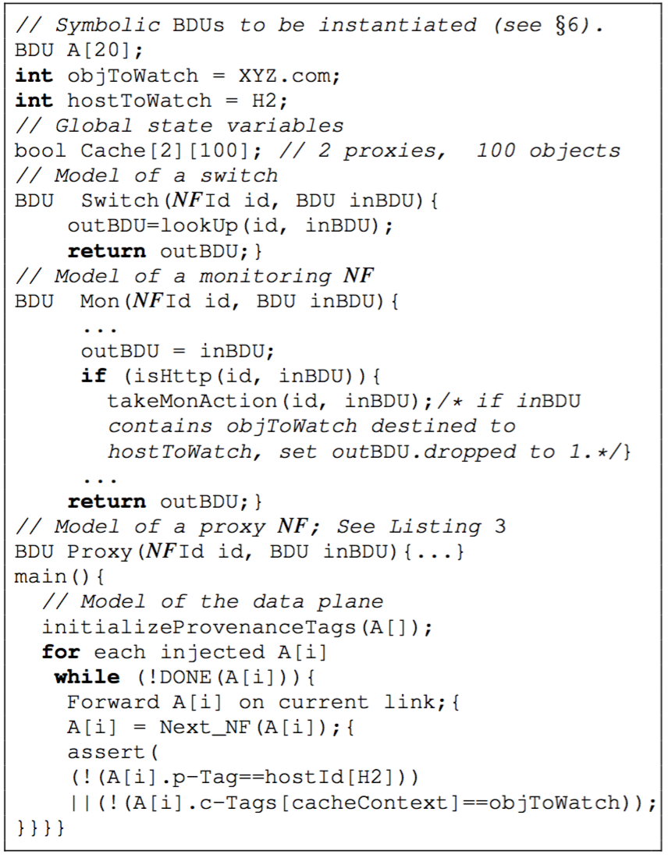
Putting it together: Composing NF models
Individual
NF models
Data plane
model

Slide 12
Challenge 2: Scalable test traffic generation
context-dependent
policies
Challenge 1:
Expressive models?
Operator
Data plane model
Challenge 2:
Scalable state space exploration
Test traffic
generation
Pass
Fail
test
traffic
FW
IPS
Proxy
stateful data plane

Slide 13
Challenge 2: Exploring data plane state space
host 1
suspicious?
host 2
Light IPS
Conceptual view of test traffic generation: How to reach a colored state through a sequence of traffic units?
Challenge of scalability wrt traffic space and state space
Strawman 1: All possible sequences of traffic units
Strawman 2: Generate random traffic units (e.g., fuzzing)
Strawman 3: Naïve use of exploration tools (e.g., model checking)

Slide 14
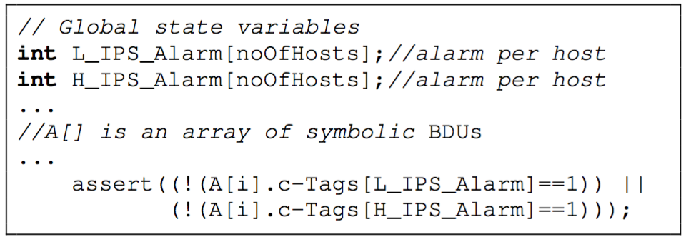
Our idea: Test traffic generation using optimized symbolic execution
host 1
suspicious?
host 2
Light IPS
Our high-level approach: Symbolic execution
Optimized symbolic execution:
Minimize the number of symbolic BDUs
Scoping values of symbolic BDUs

Slide 15
Outline
Motivation and challenges
Design of BUZZ
Implementation and evaluation

Slide 16
Implementation
Pass
Network
operator
Library of
NF models (C)
Fail
intended policies
Data plane model instantiation (C)
BDU-level test
traffic generation (KLEE+optimizations)
Policy parser
Test resolution (custom code)
Translation into test scripts (custom library + code)
monitoring logs (tcpdump)
FW
IPS
Proxy
stateful data plane under test
https://github.com/network-policy-tester/buzz

Slide 17
Evaluation: Effectiveness of BUZZ
Found new bugs in recent SDN-based systems
Violations due to reactive control in Kinetic
Incorrect state migration in OpenNF
Faulty policy composition in PGA
Incorrect traffic tagging in FlowTags
…
Found known violations
Broken link
Incorrect NAT configuration
SDN controller bug
…

Slide 18
Evaluation: Scalability of BUZZ
Test generation takes < 2min for a network with 600 switches and 60 middleboxes

Slide 19
Conclusions
Existing work has fundamental limitations in checking context-dependent policies in stateful data planes
Challenges:
Expressive-yet-scalable model of stateful data planes
Scalable state space exploration
Our solution is BUZZ:
BUZZ Data Unit (BDU) as traffic unit model
Ensemble of FSMs as a network function (NF) model
Scalable exploration via domain-specific optimizations
BUZZ can help find bugs and is scalable

